Slide 1
Intro to Unity
Basic Menu Navigation
Justin Park
and Noah Poole

Slide 2
What is Unity?
Unity is a game engine
What is a game engine?
a software framework for development of video games
Unity is cross - platform

Slide 3
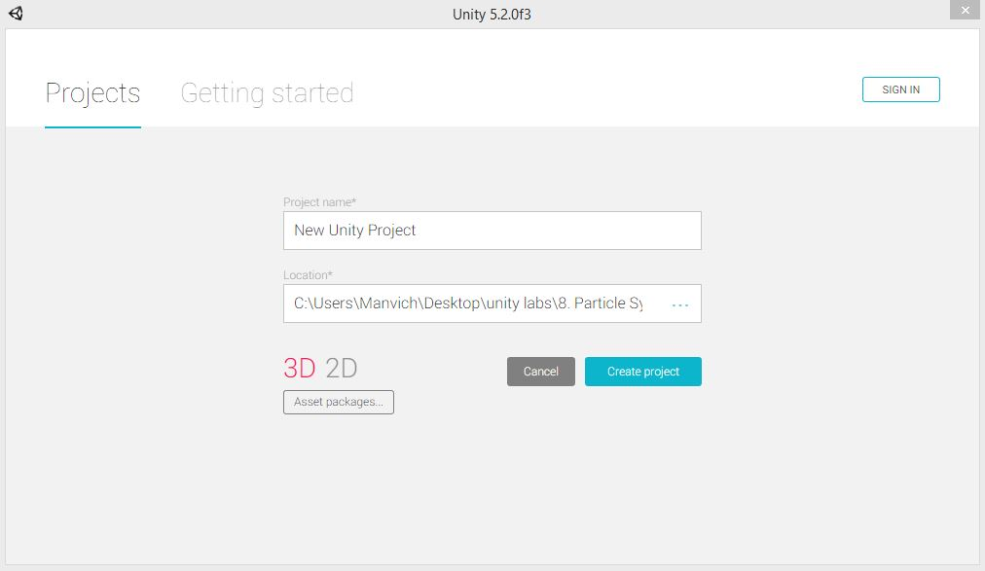
Creating a New Project
Name of folder storing
project
Open Unity File->New Project
Path to project location
Change to 2D
Leave these alone
These aren’t needed
currently

Slide 4
Creating a New Project - Steps
1. Unity
Open Unity File->New Project
1
C:\Users\Neato\Desktop\Notes\Unity
2
Change to 2D
3
4
Press when done

Slide 5
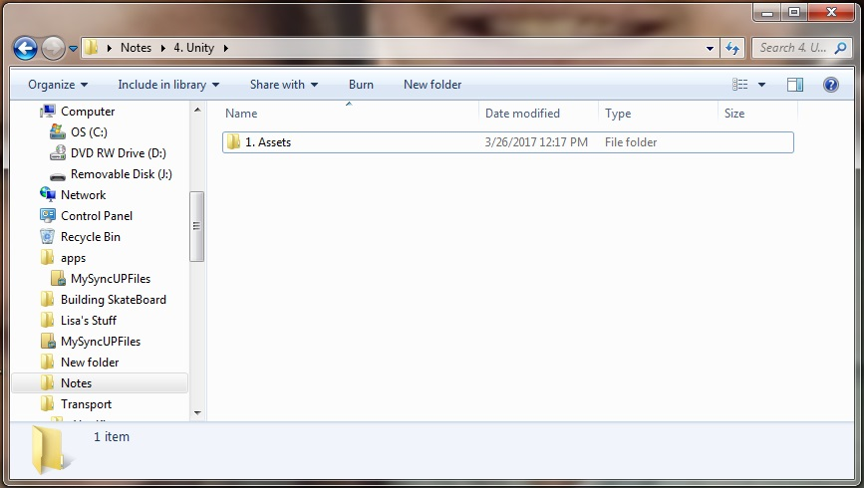
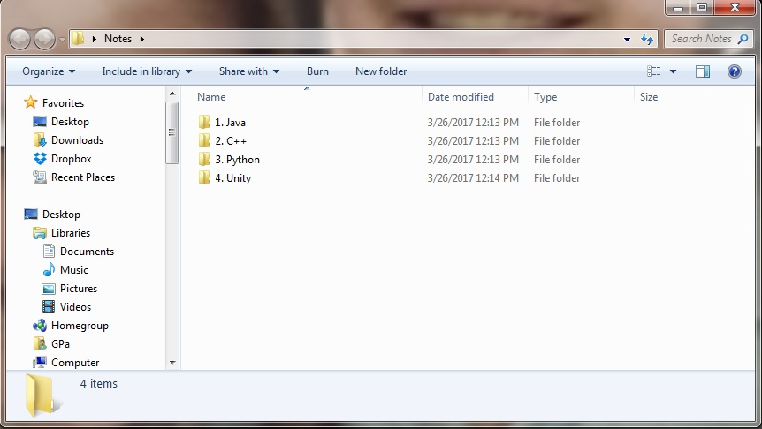
Windows File Manager View
1. Assets
1
C:\Users\Neato\Desktop\Notes\4.Unity
2
Change to 2D
3
4
Press when done

Slide 6
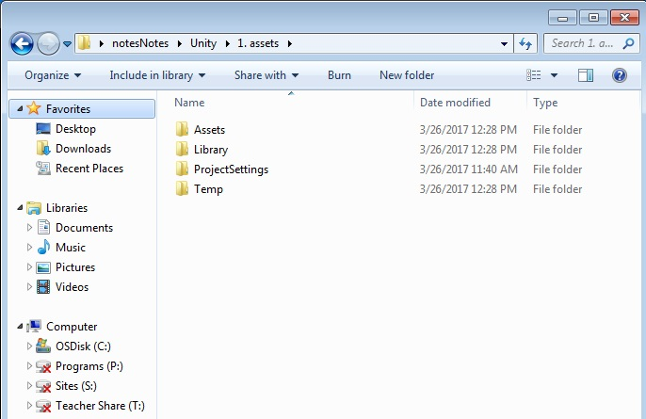
Inside the “1. Assets” folder….
Happens automatically!

Slide 7
What is an Asset?
jpg
GameObject (don’t know what that is yet)
script (some code)
Scene
.
.
.

Slide 8
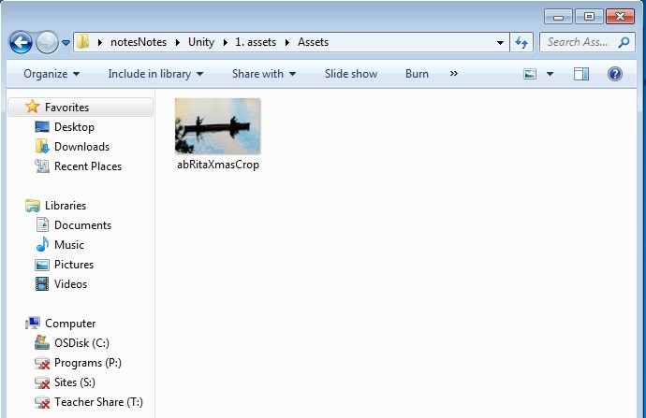
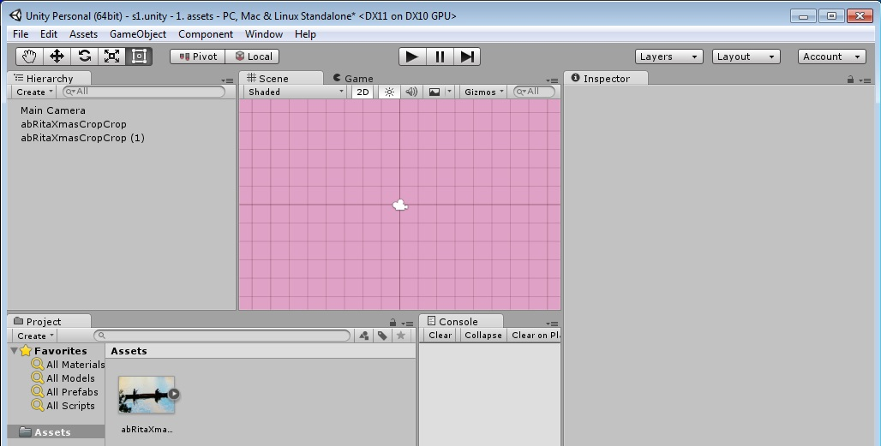
Inside the “Assets” folder is where we put our Assets Example:
Windows File manager
Within Unity
Same Asset seen 2 different ways

Slide 9
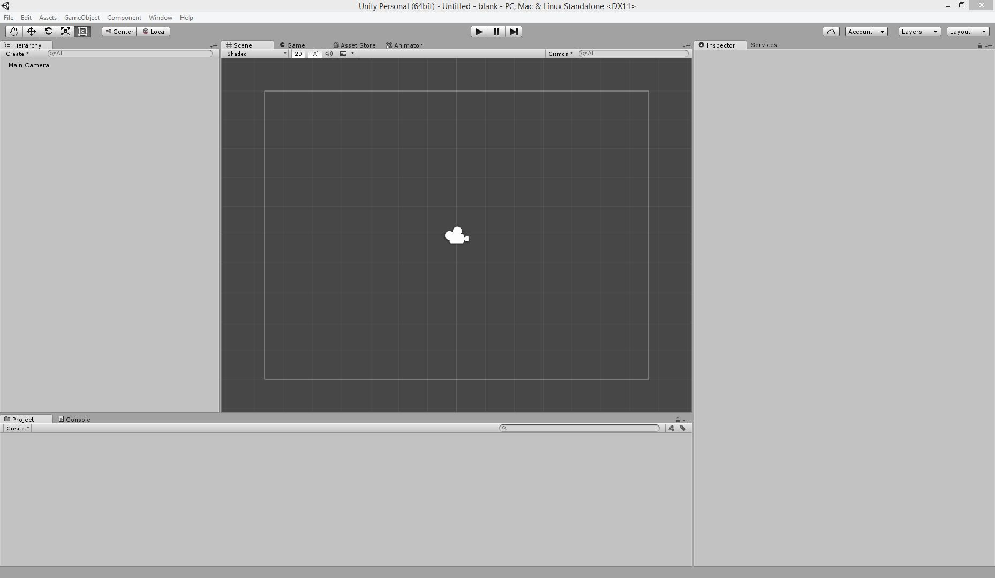
Menu
Preview of Scene during Play
Scene
Information about
selected
object
Pan
List of Objects in the scene
Stored files (Assets) in the project

Slide 10
Windows
If you are missing a window, the missing windows can be brought back through Window->Layouts->Default
You can arrange windows by dragging tabs

Slide 11
Lab 1
Get a pic of something you want to build a game around (your face, your dog,…)
Turn it into an asset
Make a project and load multiple copies of your asset into a scene

